Slide 1
Electronic P&T Database Department Chair Guide
https://promotiontenure.uams.edu/

Slide 2
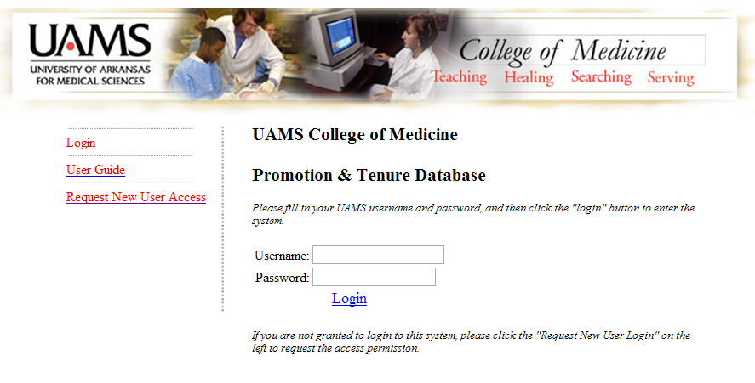
Log In
To access the system, use your UAMS system username and password.

Slide 3
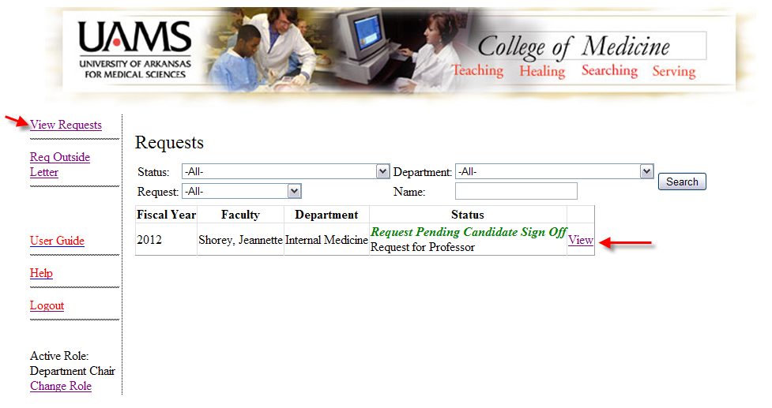
View Requests
This screen will display all of the pending requests for your department. To see an individual’s record, click ‘View’ next to his/her name.

Slide 4
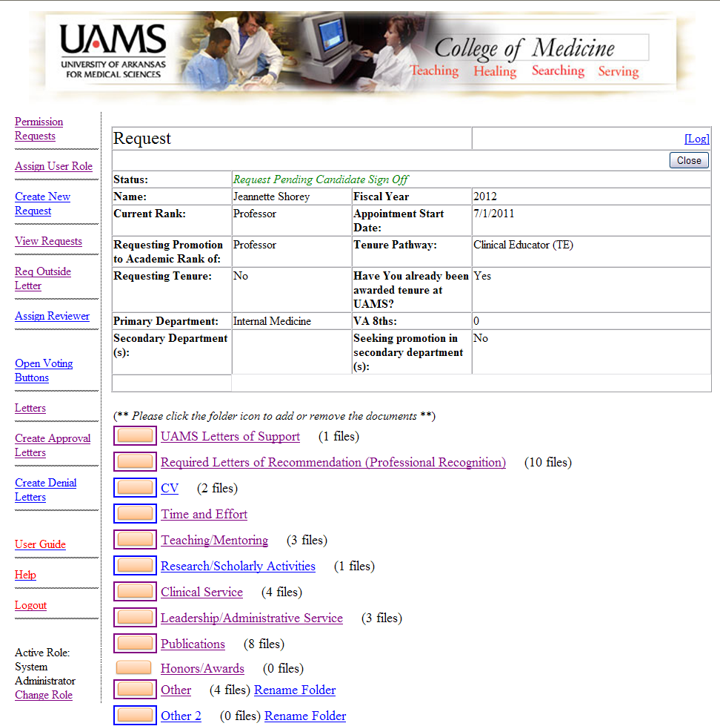
Individual Candidate’s Screen

Slide 5
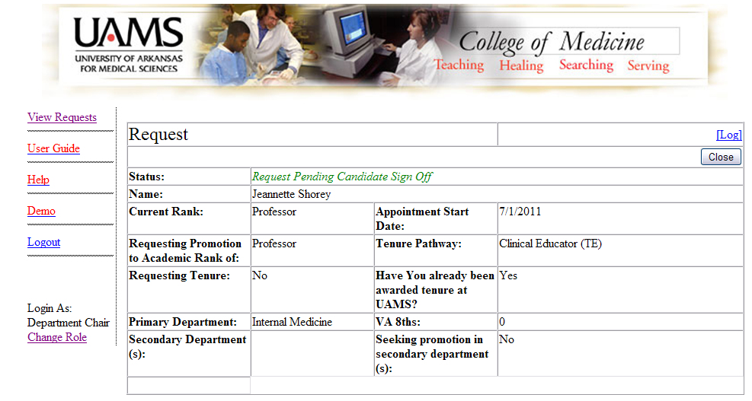
Individual Candidate’s Screen (top)
The top portion of this screen will show the candidate’s current information as well as the promotion and/or tenure request.

Slide 6
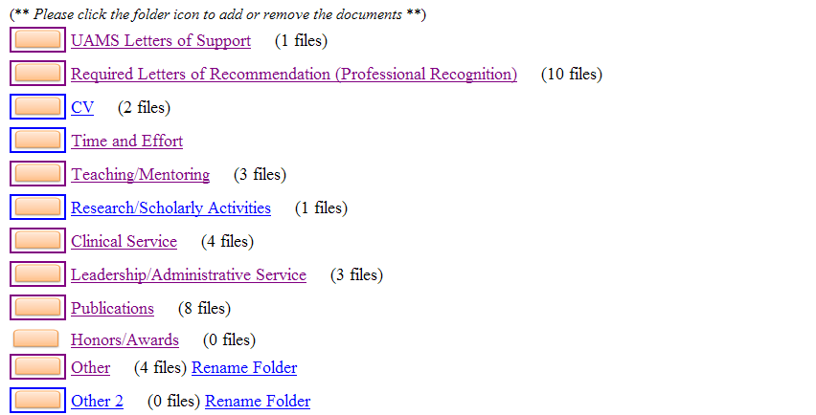
Individual Candidate’s Screen (bottom)
The bottom portion of this screen shows the folders where candidates will upload supporting documents for the request.

Slide 7
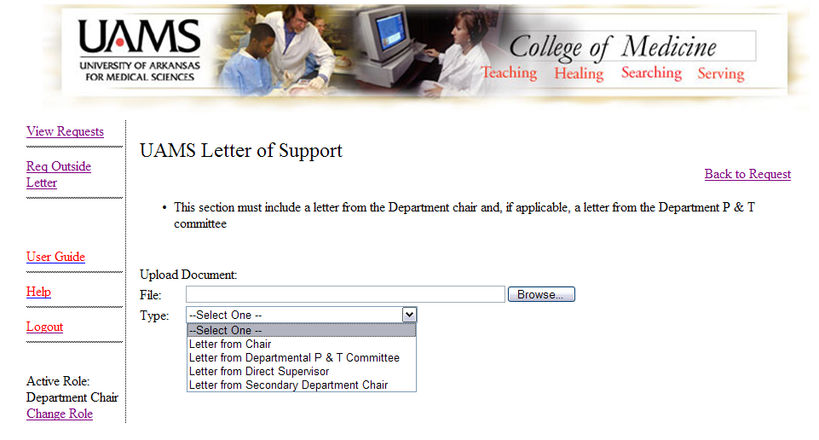
Folder View – Upload Documents
Within each folder, individual documents can be uploaded. Click ‘Browse’ to find the document on your computer. Select a document type from the drop-down box and click ‘Upload’.

Slide 8
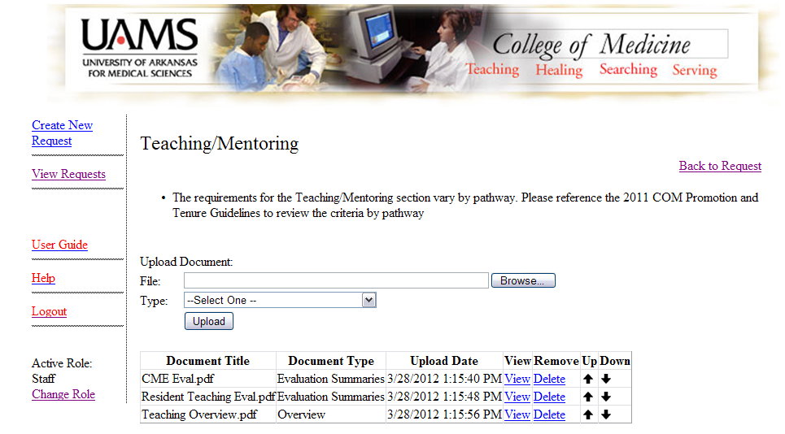
Folder View – Organize Documents
Once documents have been uploaded within the folders, they can be sorted into the desired order with the up/down buttons.

Slide 9
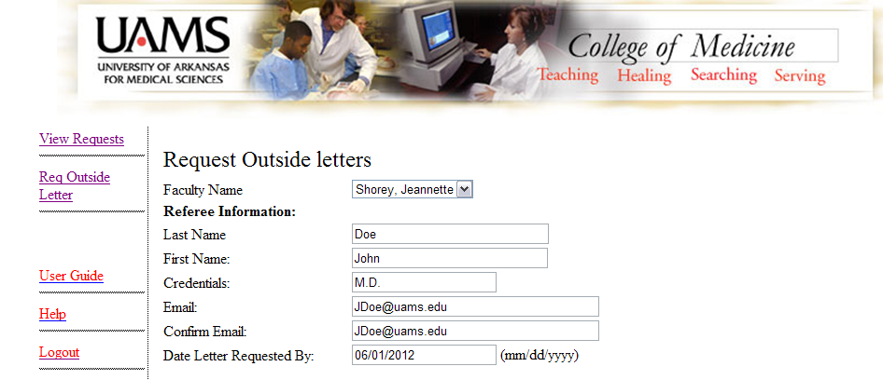
Request Outside Letters
To request outside letters within the system, select the candidate’s name from the drop down field. Complete the requested referee information. This will auto-populate the email shown below the fields (as seen on the following slide).

Slide 10
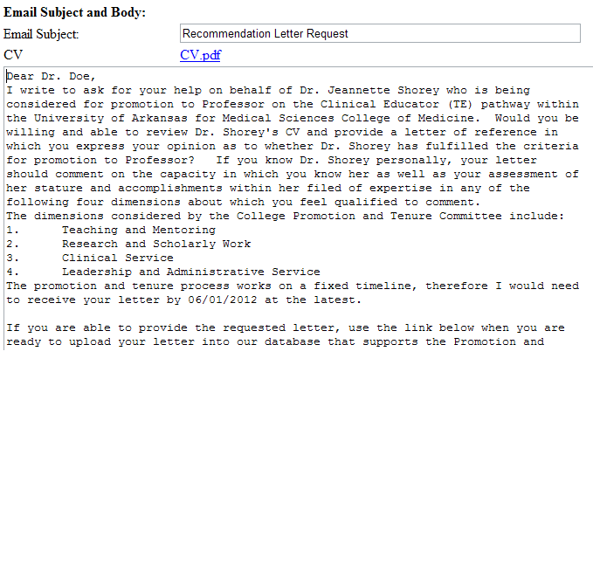
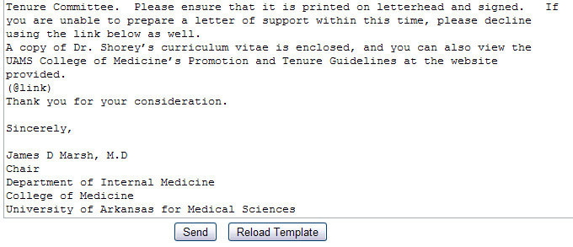
Request Outside Letters
The generated email is shown below the requested fields. The system will auto-populate as the fields are completed. If a mistake is made, simple click ‘Reload Template’ once it has been corrected. The email can also be manually edited as desired.
If a candidate’s CV has been uploaded in the system, it will also automatically be attached to the email. The COM P&T guidelines are also linked within, so you don’t have to attach to the email.

Slide 11
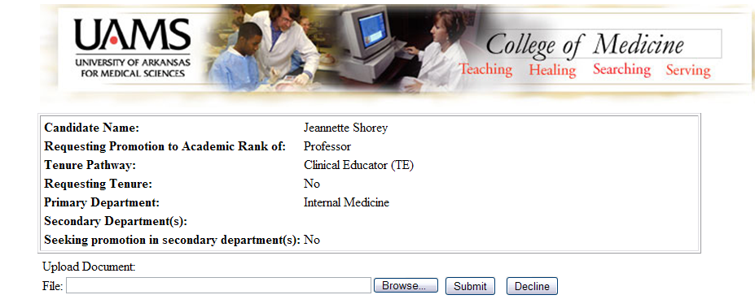
Referee Screen
Once the referee logs into the system, s/he will be taken to this screen. Here a document can be uploaded. If the referee is unable to complete the request, s/he can decline. With either action, an email notice will be sent to the person who sent the request to the referee.
Directions for the referee as well as the link to the P&T document are also provided on this screen.

Slide 12
Contact Information
Office of Faculty Affairs:
Emily Freeman
ESFreeman@uams.edu
526-4684
IT Development:
Daojun Liu
DLiu@uams.edu
686-7488
Kerstine Wanas
KWWanas@uams.edu
526-4661

